Slide 1
Full Stack Project
Laith khater 323965152
Rami hanna 323956557

Slide 2

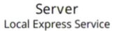
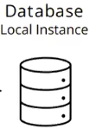


















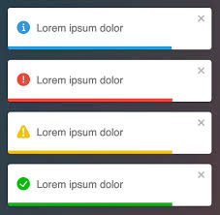


Top-down View
axios
mysql
React jsx
Node.js
fs
SQL
Express.js
jsonwebtoken
CSS
bcrypt
multer
Chart.js
Body-parse
mysql
React-chart.js-2
Cookie-parser
nodemon
React - toastify
Cors
path

Slide 3
About the project
באפליקציה יש 2 סוגים של משתמשים יש login ו register ולפי המייל יודעים מי המרצה ומי הסטודנט :
1- מורה : - יכול להוסיף כיתה חדשה עם ציונים
- יכול להוסיף סטודנט חדש לכיתה עם הציונים הרלוונטיים לכיתה הזאת
- יכול להוסיף עבודת בית עם תאריך וקובץ כלשהו
- יכול לעדכן הנוכחות לכל כיתה ולכל סטודנט
- יש אפשרות גם לראות מאזן הציונים לכל כיתה וגם יש גרף לכל כיתה ( יש אפשרות לערוך הציונים גם )
2- סטודנט :
- יכול לראות הציונים שלו בכל הקורסים כולל הציון הסופי
- יש אפשרות גם להגיש את עבודות הבית

Slide 4
Technology Stack Overview
We implemented the project using the following technologies:
Client Side : HTML, CSS, JavaScript, Bootstrap
Server Side : Node Js
Database : phpMyAdmin ( SQL Server )

Slide 5
What the application do - Features
Login
Register
Logging Exceptions
Teacher - > add class
Teacher -> add student
Teacher -> add homework
Teacher -> attendance check
Teacher -> edit grades
Teacher -> class grades
Teacher -> grades graph
Student -> see and submit homework
Student -> see grades

Slide 6
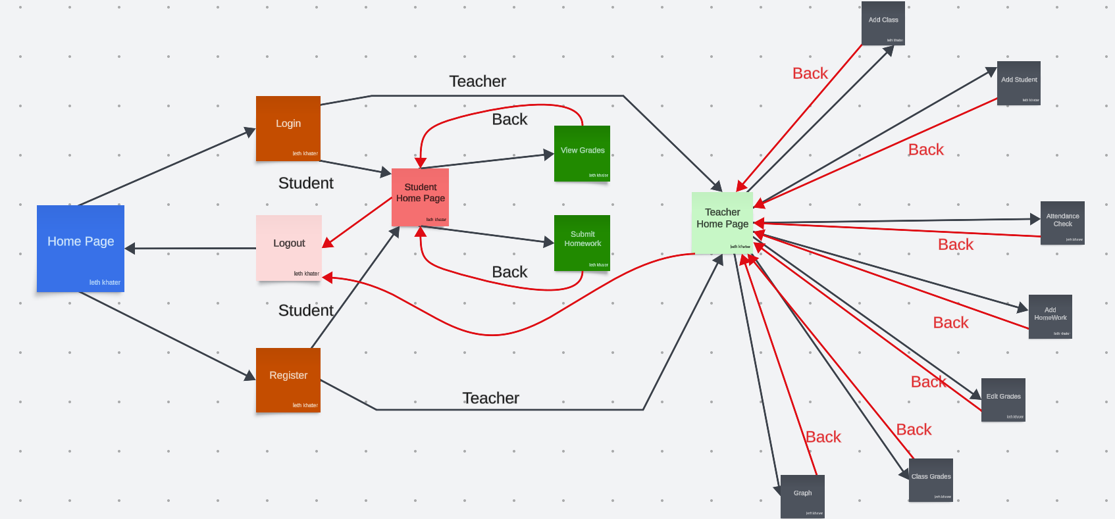
Use Case Diagram – Main Process

Slide 7

Home Page

Slide 8
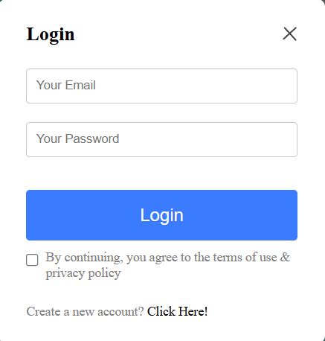
Student / Teacher login page

Slide 9
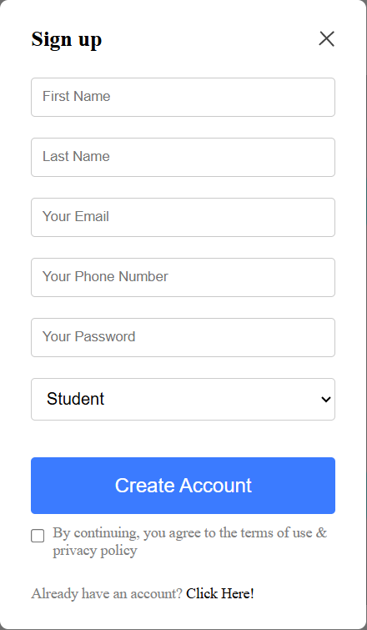
Student / Teacher register page

Slide 10
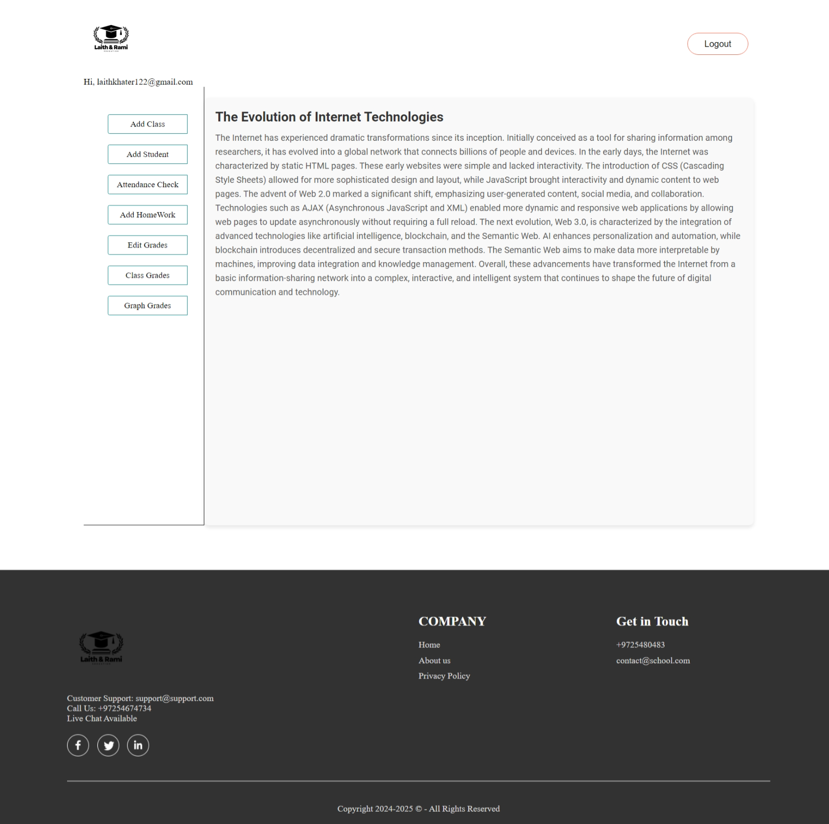
Teacher Main Page

Slide 11
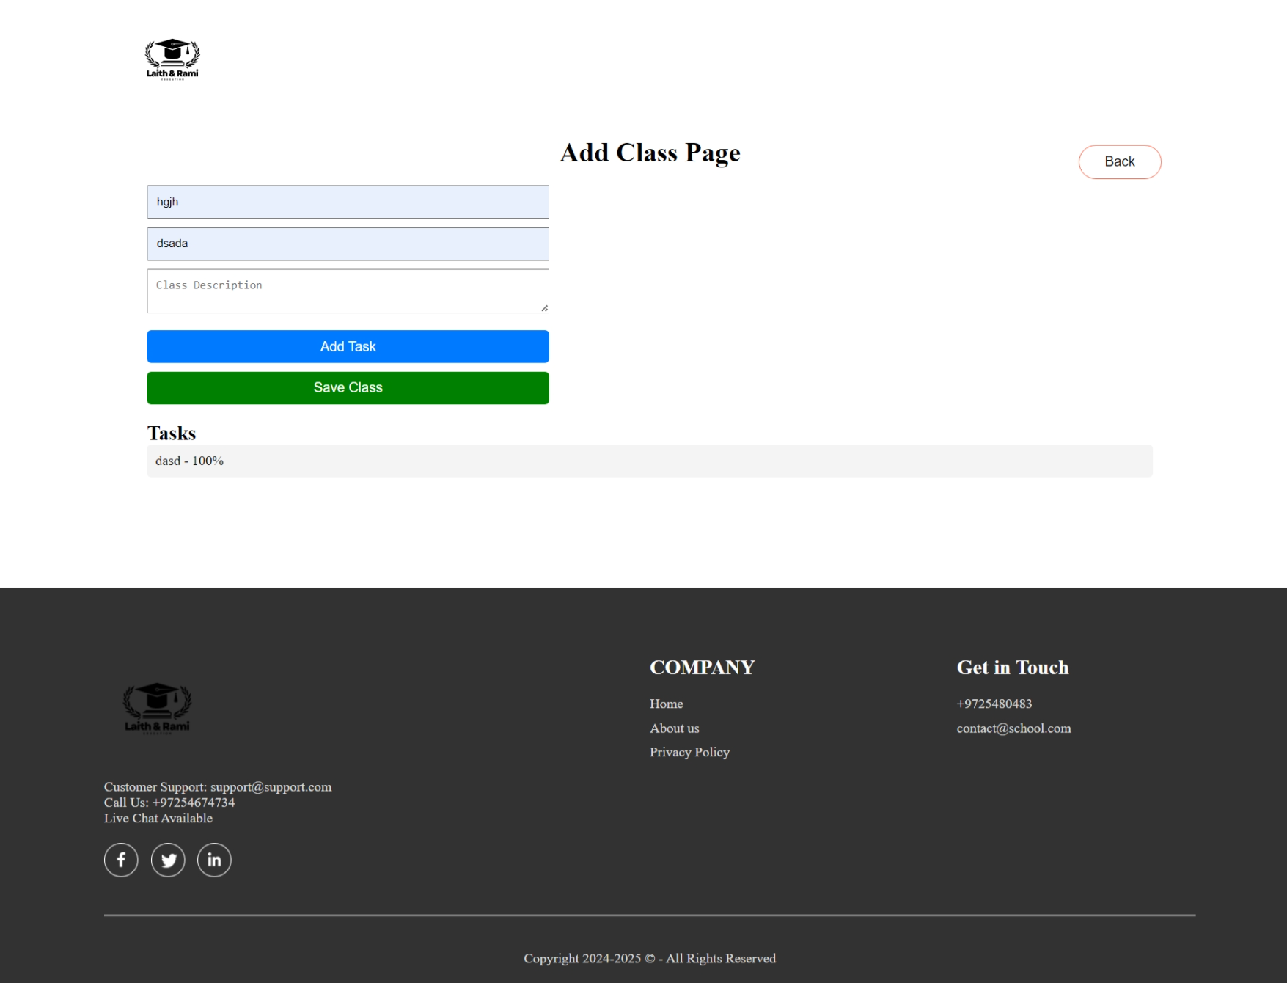
Teacher – Add Class Page

Slide 12
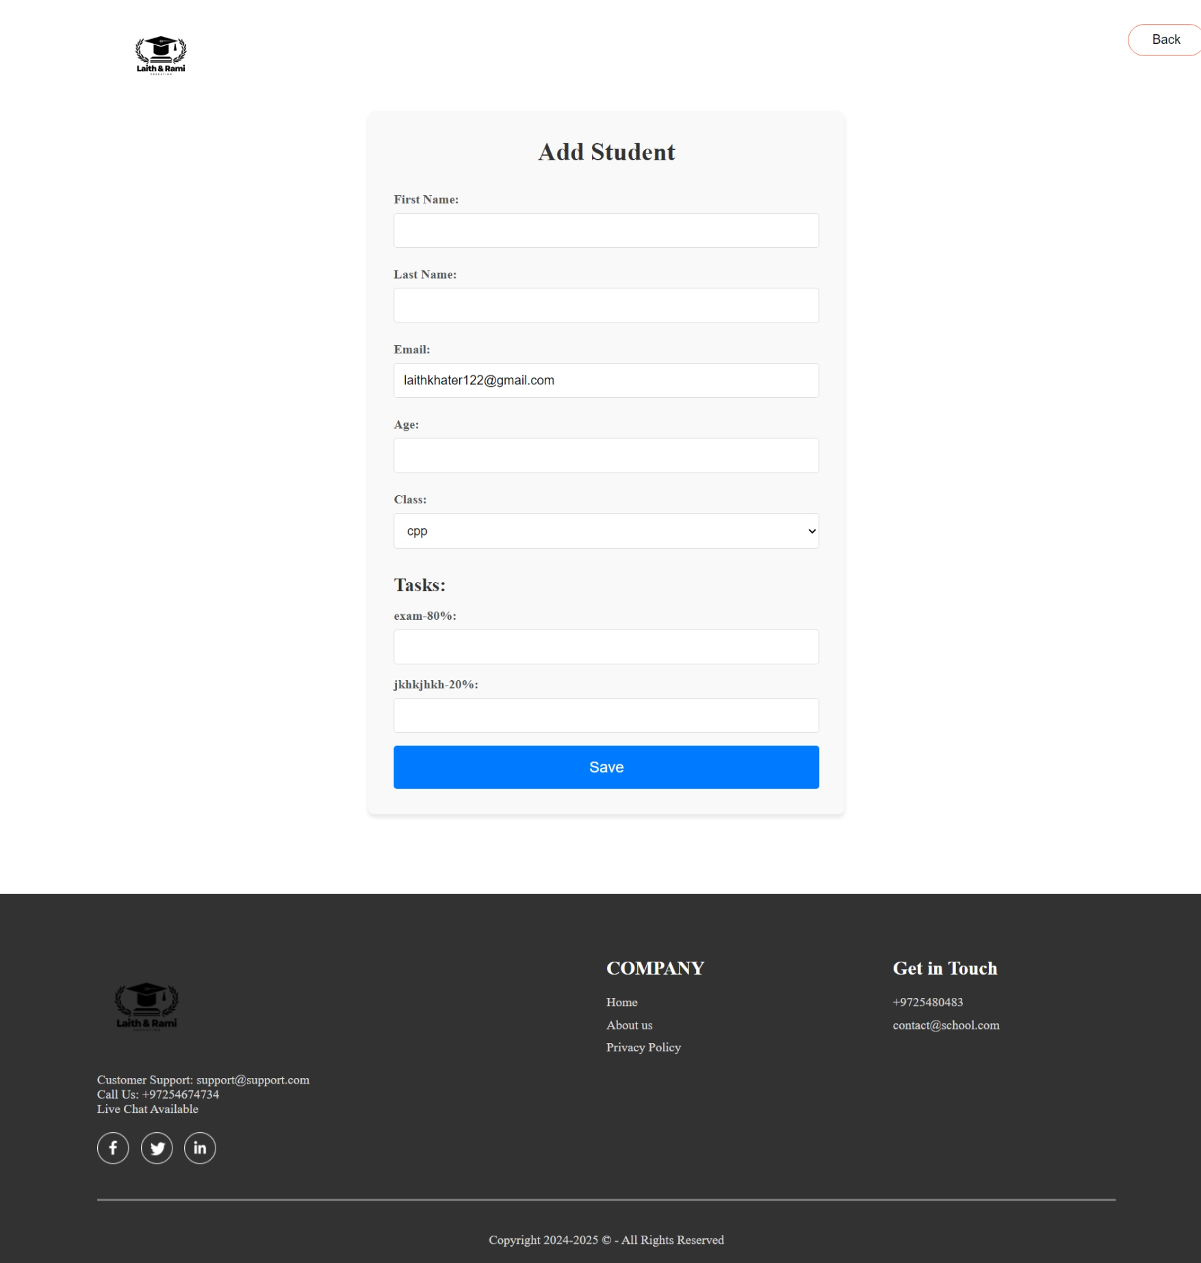
Teacher – Add Student Page

Slide 13
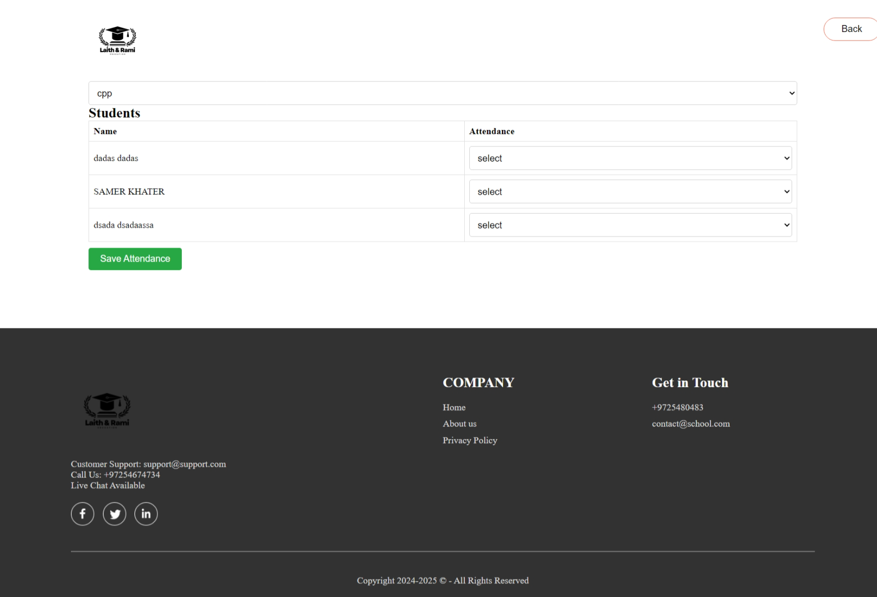
Teacher – Attendance Check Page

Slide 14
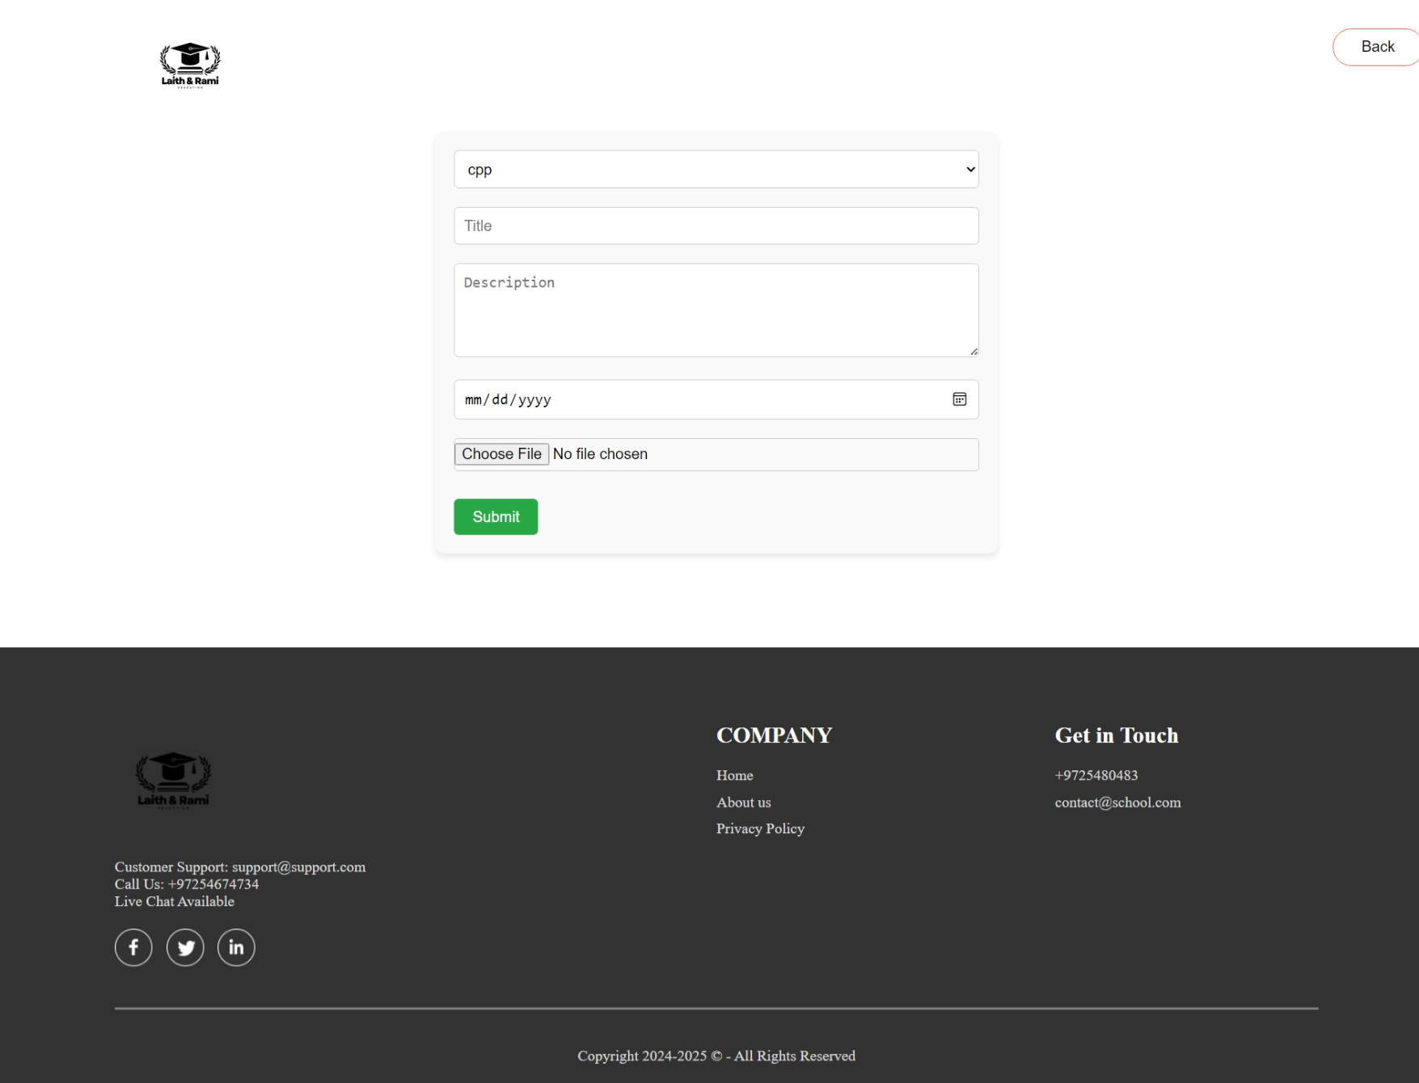
Teacher – Add Homework Page

Slide 15
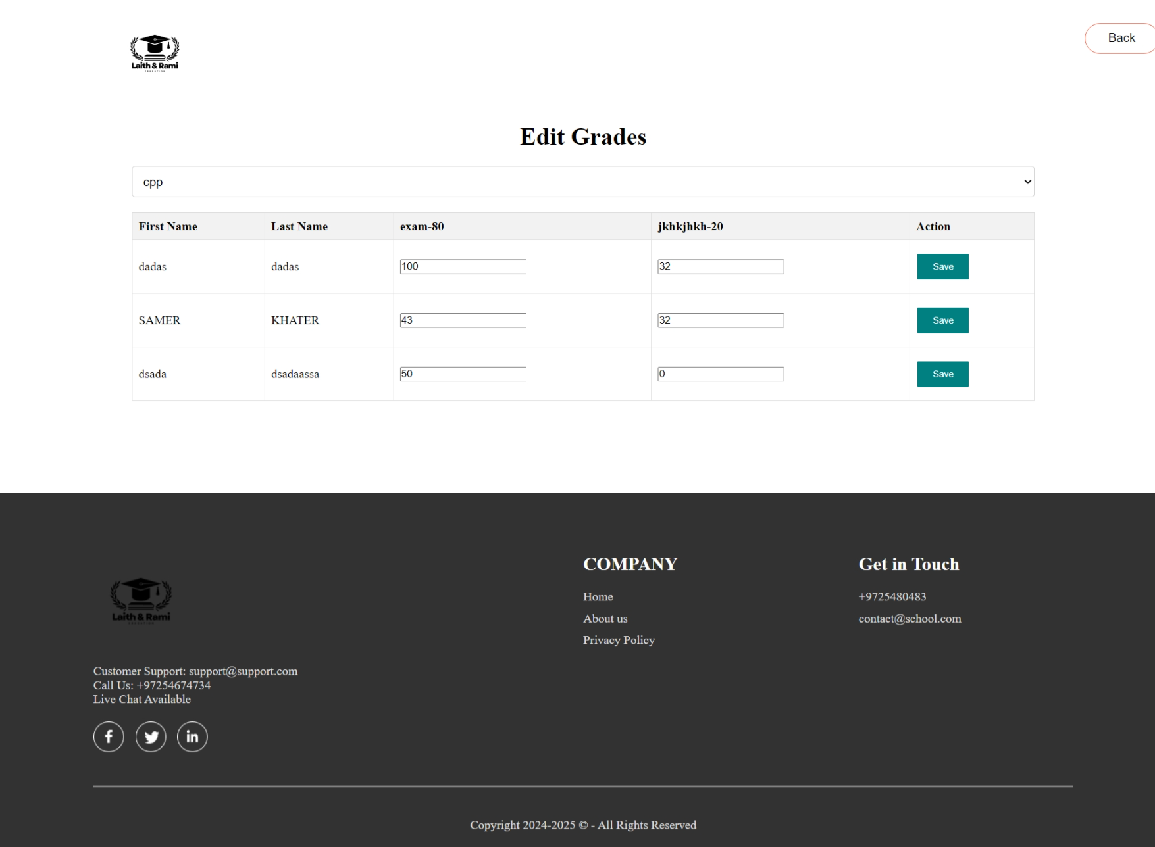
Teacher – Edit Grades Page

Slide 16
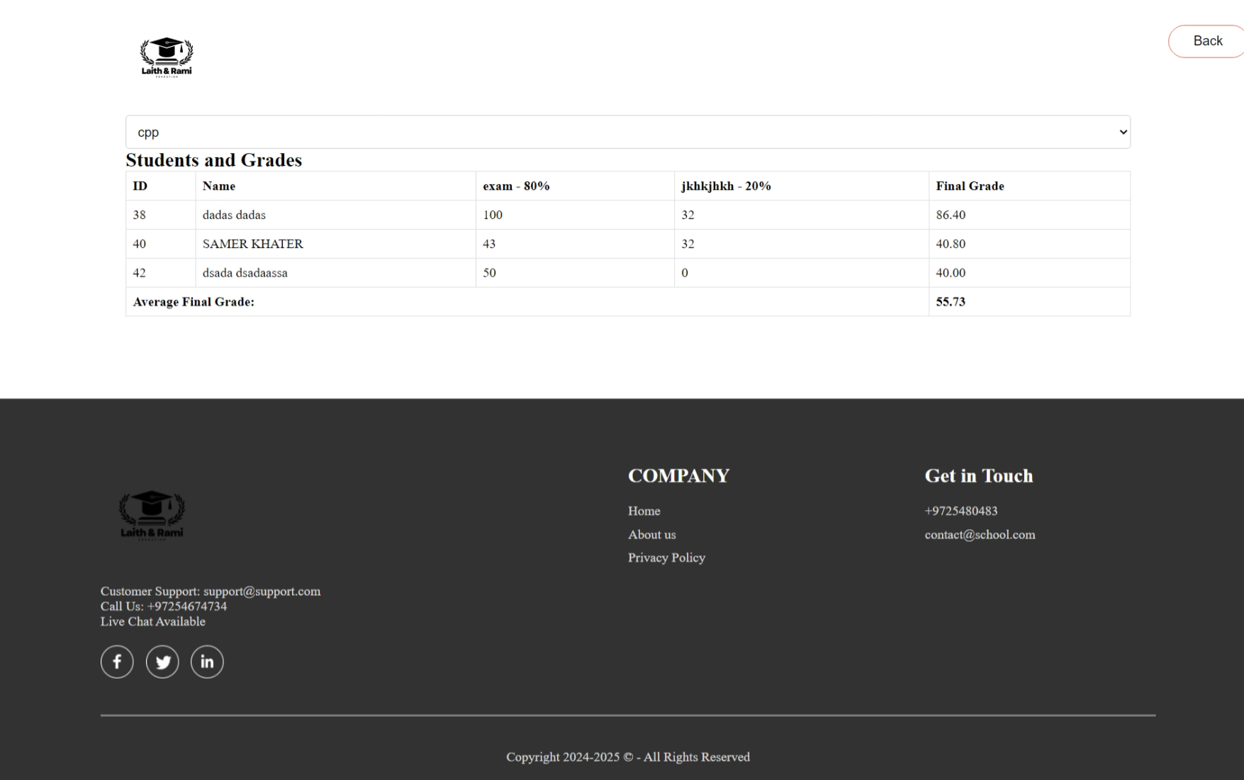
Teacher – View Grades Page

Slide 17
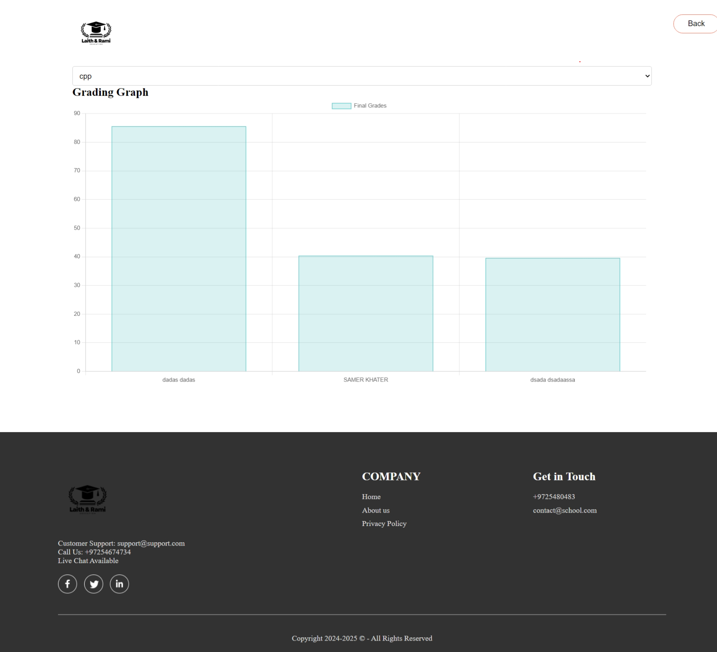
Teacher – Grades Graph Page

Slide 18
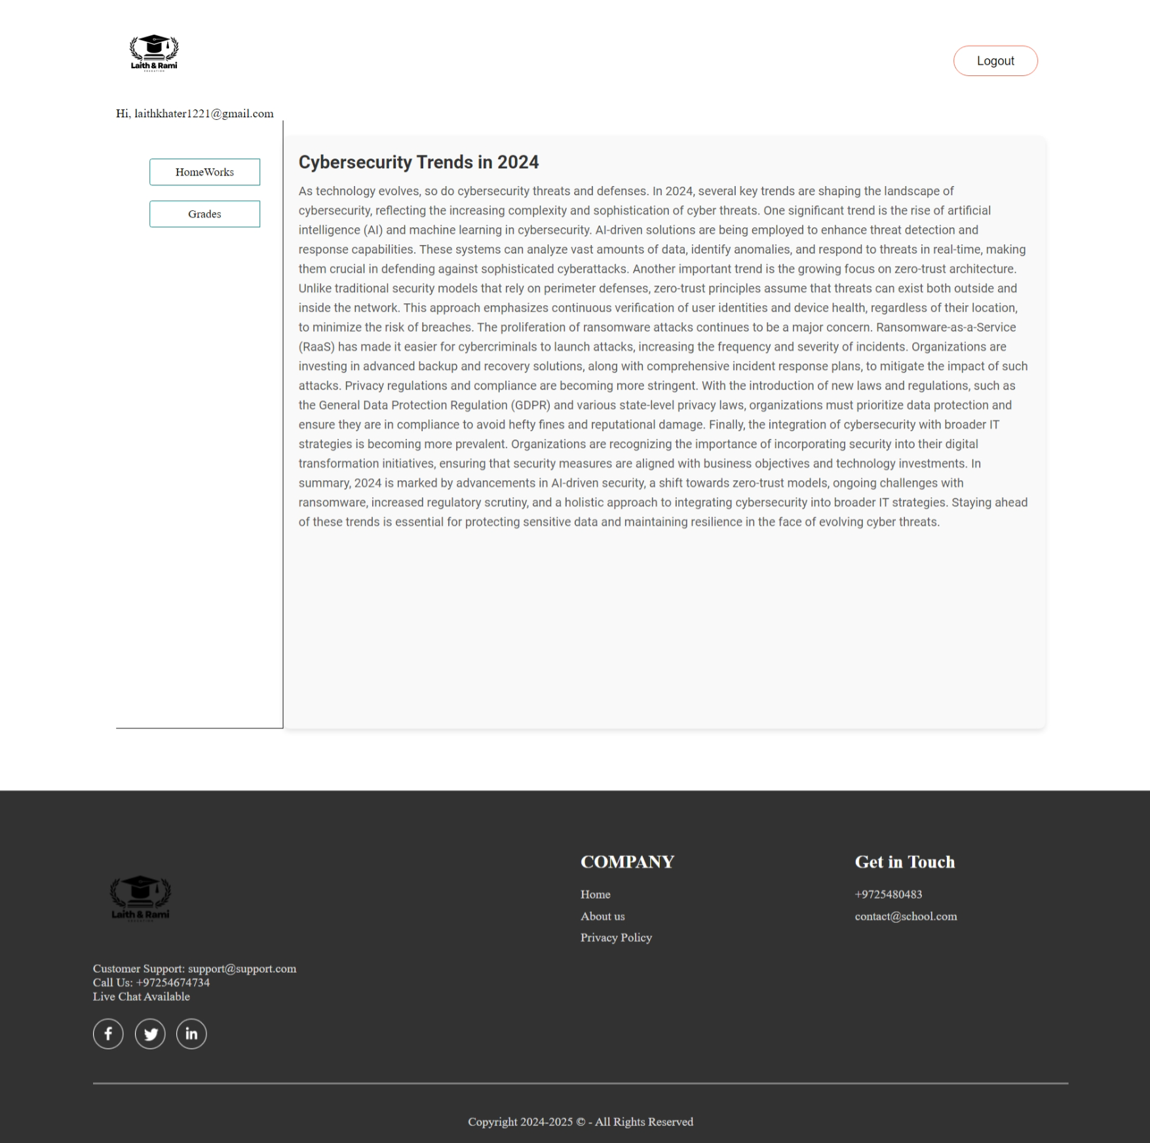
Student Main Page

Slide 19
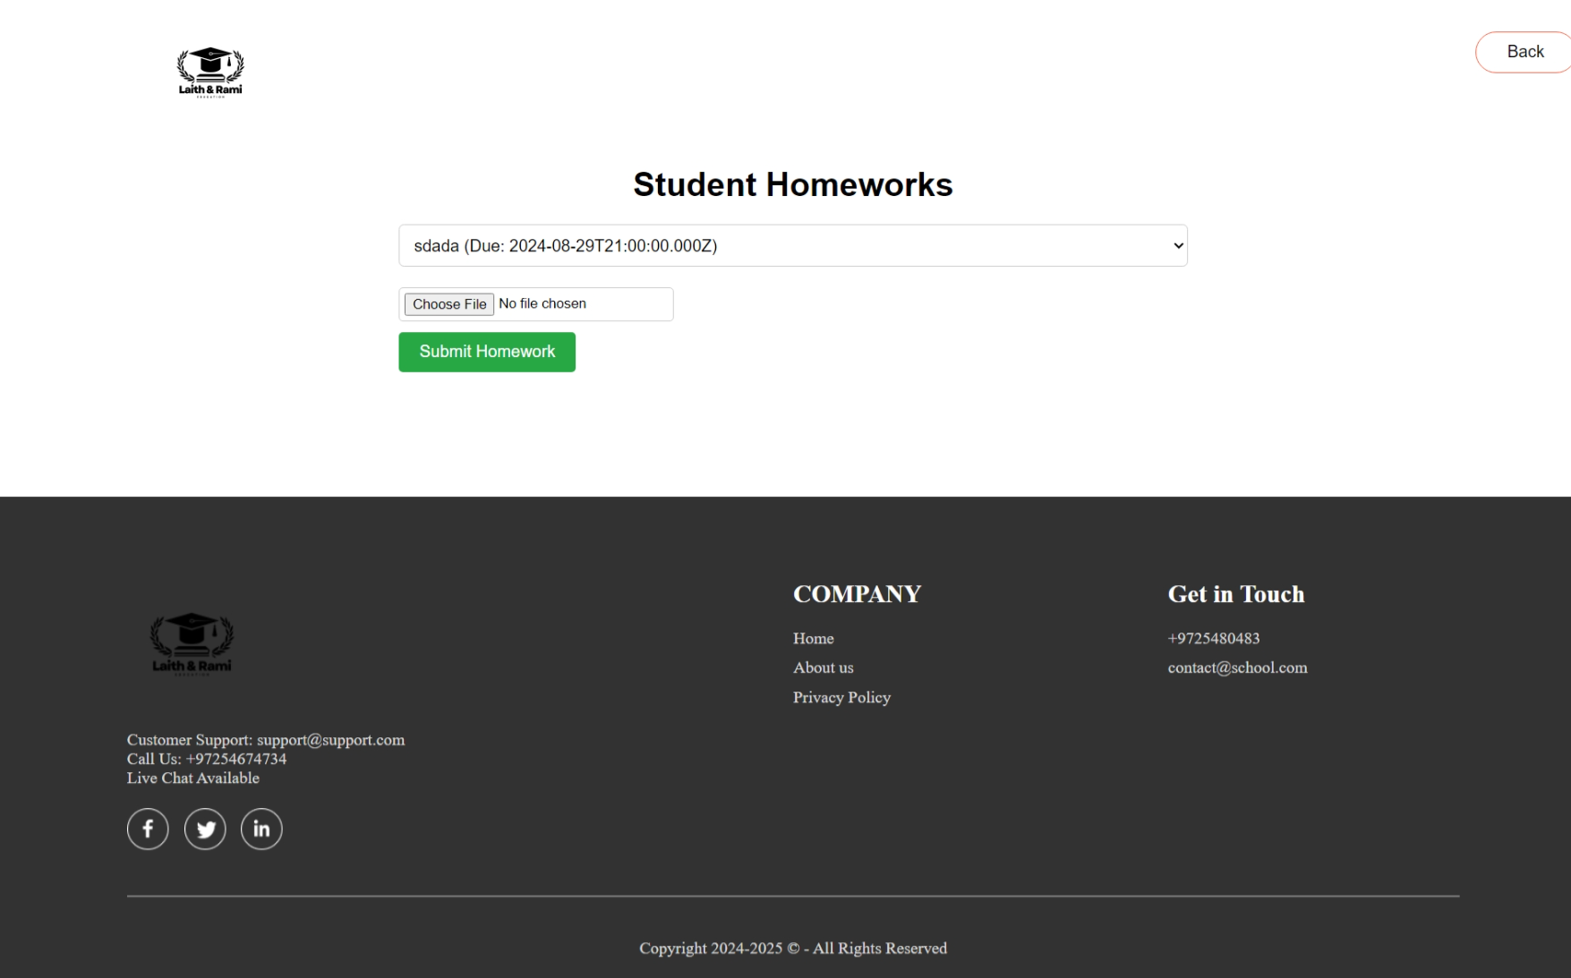
Student – HomeWorks Page

Slide 20
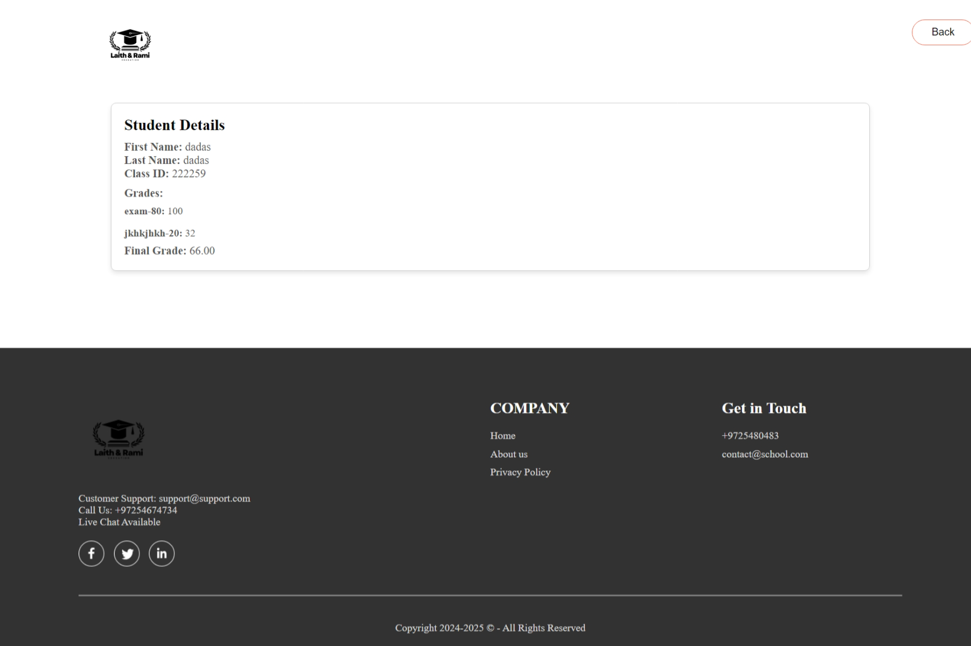
Student – Grades Page

Slide 21
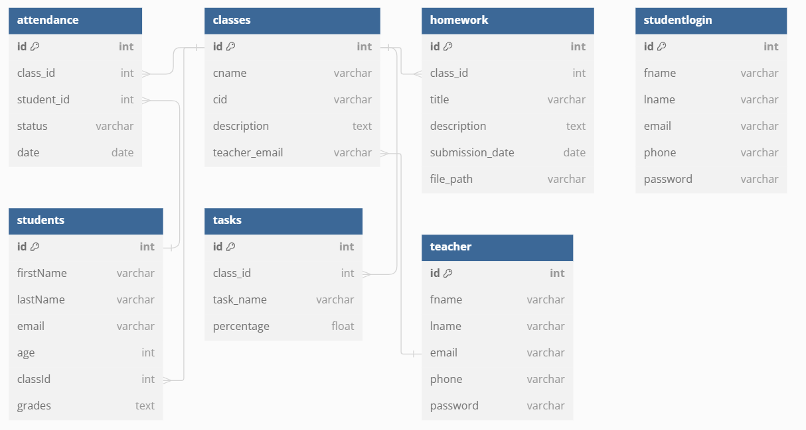
Classes Diagram

Slide 22
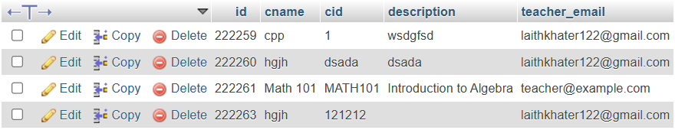
DB – attendance table
DB – classes table

Slide 23
DB – homework table
DB – student login table
DB – teacher table

Slide 24
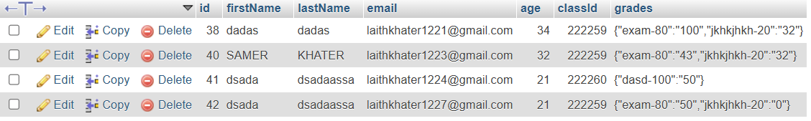
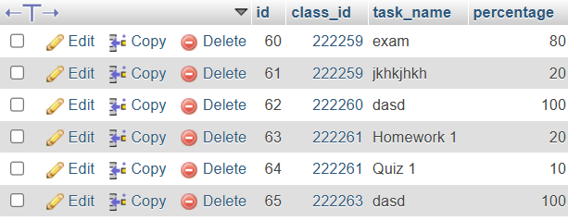
DB – students table
DB – tasks table

Slide 25
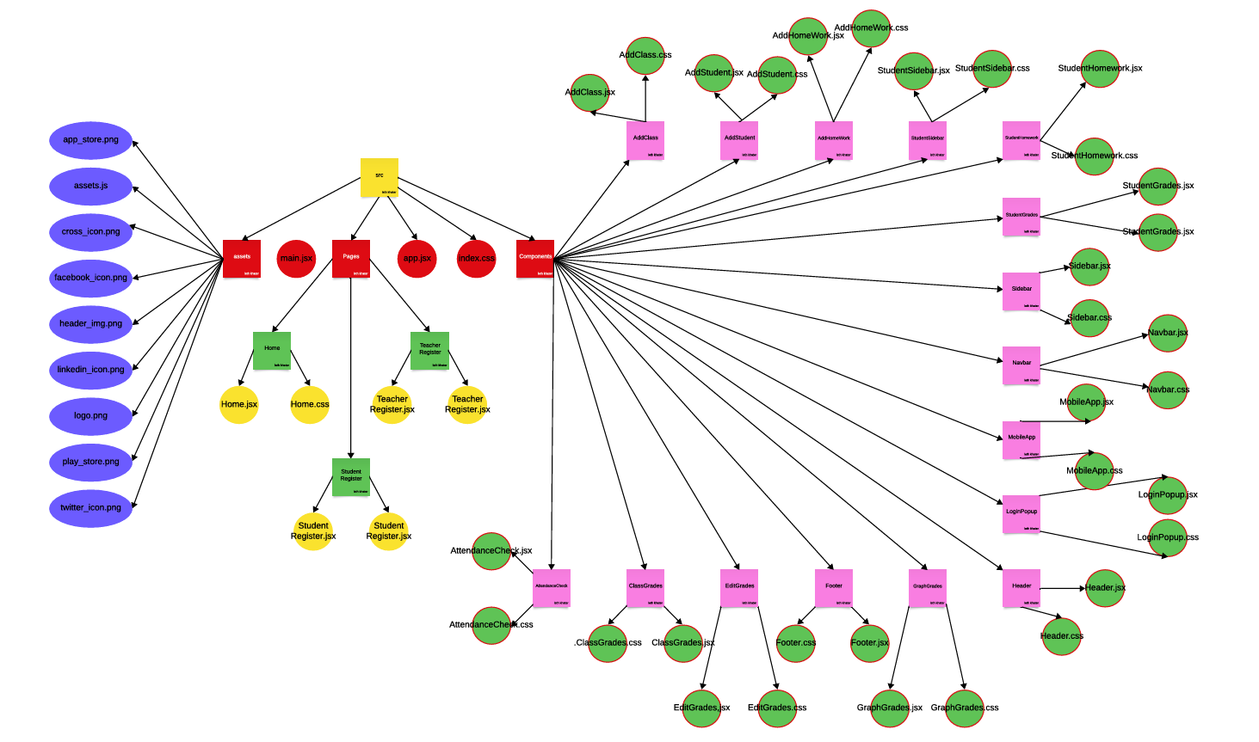
Client Side – Project Tree

Slide 26
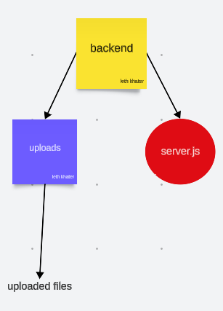
Server Side – Project Tree

Slide 27
API Endpoints
Path | Method | Params | Returns
/register | POST | { "fname": "John", "lname": "Doe", "email": "john.doe@example.com", "phone": "123-456-7890", "password": "securepassword123", "role": "Student" } | HTTP Status: 200 OK { "Message": "Student registered successfully!" } Or { "Message": "Teacher registered successfully!" }
/login | GET | Query Parameters (from req.query): - email: The email address of the user trying to log in. - password: The password provided by the user for authentication. | Success teacher : { "success": true, "message": "Login successful", "role": "Teacher" } Success Student : { "success": true, "message": "Login successful", "role": "Student" }

Slide 28
API Endpoints
Path | Method | Params | Returns
/api/classes | POST | { "cname": "Mathematics 101", "id": 123, "description": "Introduction to basic mathematics.", "tasks": [ { "taskName": "Homework 1", "percentage": 20 }, { "taskName": "Midterm Exam", "percentage": 30 } ], "teacher_email": "teacher@example.com" } | If tasks are provided and successfully inserted: { "Message": "Class and tasks saved successfully!" } If no tasks are provided: { "Message": "Class saved successfully without tasks!" }
/api/classes | GET | Request Parameters: The endpoint does not expect any URL parameters, query parameters, or request body data. It simply responds to a GET request at the /api/classes route. | [ { "id": 1, "cname": "Mathematics", "cid": "MATH101", "description": "Introduction to Mathematics", "teacher_email": "teacher1@example.com" ]

Slide 29
API Endpoints
/api/tasks/:classId | GET | Path Parameter (req.params):classId (string): This is the ID of the class for which tasks are being retrieved. It is specified as a part of the URL path. | [ { "id": 1, "title": "Task 1", "description": "Description for task 1", "due_date": "2024-08-30", "class_id": 101 } ]
/api/students | POST | { "firstName": "John", "lastName": "Doe", "email": "john.doe@example.com", "age": 20, "classId": 101, "grades": { "math": 95, "science": 88 } } | Success Response: Status Code: 200 OK Body: { message: 'Student added successfully’ } Error Response (Invalid classId): Status Code: 400 Bad Request Body: { error: 'Invalid classId’ }

Slide 30
API Endpoints
/api/classes/:email | GET | This is a URL parameter (specified as :email in the route). It represents the email address of the teacher whose classes you want to retrieve. | [ { "id": 1, "cname": "Mathematics", "cid": "MATH101", "description": "Basic Mathematics", "teacher_email": "teacher@example.com" } ]
/api/students/:classId | GET | This is a required parameter in the URL path. It specifies the ID of the class for which you want to retrieve students. | [ { "id": 1, "firstName": "John", "lastName": "Doe", "email": "john.doe@example.com", "age": 20, "classId": 10, "grades": "A, B, C" } ]

Slide 31
API Endpoints
/api/saveAttendance | POST | [ { "class_id": 101, "student_id": 1, "status": "present", "date": "2024-08-24"} ] | Success Response: Status Code: 200 OK JSON Body: { message: 'Attendance saved successfully’ } Error Response: Status Code: 500 Internal Server Error JSON Body: { error: 'Failed to save attendance' }
/api/saveHomework | POST | { "title": "Math Homework 1", "description": "Complete the exercises on page 45", "submissionDate": "2024-09-15", "classId": "12345" } | Success (200 OK): { "message": "Homework saved successfully" } Error (500 Internal Server Error): { "error": "Failed to save homework" }

Slide 32
API Endpoints
/api/attendance/:studentId | GET | The ID of the student whose attendance records are being queried. This value is provided in the URL path. | Successful Response : [ { "student_id": 123, "date": "2024-08-01", "status": “here" } ] Error Response : { "error": "Internal Server Error" }
/api/students/:id | PUT | { "grades": { "math": 90, "english": 85 } } | Success: { "message": "Grades updated successfully" } Error : { "error": "Internal Server Error" }

Slide 33
API Endpoints
/api/students | GET | Query Parameter: email | Status Code: 200 OK [ { "id": 1, "firstName": "John", "lastName": "Doe", "email": "student@example.com", "age": 20, "classId": 101, "grades": { "math": 95, "science": 88 } } ] Status Code: 404 Not Found { "Error": "Student not found" }
/api/classes/:cid | GET | Path Parameter: cid - This is a dynamic path parameter representing the class ID. It is used to identify which class to fetch from the database. | Status Code: 200 OK { "className": "<Class Name>" } Database Error: { "error": "Database error" }

Slide 34
API Endpoints
/api/homeworks/:classId | GET | Path Parameter: classId | [ { "id": 1, "class_id": 101, "file": "homework1.pdf", "due_date": "2024-09-01" }]
/api/submitHomework | POST | Request Body: homeworkId (string): Provided as part of the form-data in the request body. File: file (File): Uploaded with the request and accessible via req.file. | Success Response: { "message": "Homework submitted successfully" }

